Slide 1
A Seminar on Authentication Using Encrypted Negative Password
Team Details
K. Sai Vamshi(20EG105356)
L. Neha Reddy(20EG105358)
K. Anish Chandra(20EG105355)
Project Supervisor
Dr. T Shyam Prasad
M.Tech(CSE), Ph.D
Assistant Professor,CSE
Anurag University

Slide 2
Introduction
Secure password storage and authentication schemes are the backbone of the Internet. Any website which has user accounts should store its users’ data as securely as possible, since any passwords which are broken can be used to log into users’ accounts on other websites due to the commonality of password reuse. In addition, due to users choosing insecure passwords, simply hashing the given password is often not enough to prevent passwords from being discovered if an internal data table is stolen. Due to the importance of this problem, there have been several schemes which have been both proposed and used over the years.There are various authentication schemes available but each one has its own share of advantages as well as disadvantages.
So, there is a need for a robust system to secure passwords to ensure both usability and security.
The applications of Encrypted Negative Passwords are : Corporate Security Systems, E-Commerce and Banking Platforms , Social Media, Cloud Service Providers, etc.

Slide 3
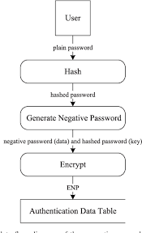
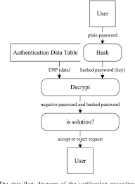
Concept Tree
Authentication
Registration
Verification

Slide 4
Literature
Strategies | Advantages | Disadvantages
Text-based passwords | Easy to implement, Cost-effective, flexible for users, Most-Popular method | Security Concerns, User behavior, Password Management.
Biometric Authentication | High security, Difficult to forge. | Cost, Privacy concerns, Spoofing risks.
Time-Based One-Time Password (TOTP) | Dynamic Security codes, cost-effective | Time-dependent, Device-dependent, Potential for Interception.
Token-based Authentication | Difficult to replicate, Multiple Authentication factors. | Cost, Token loss.
Graphical Password Authentication | Memory recall, Resistance to keyloggers, Customization. | Limited security, Shoulder surfing, Usability issues, limited adaptation.
Multi-Factor Authentication (MFA) | Enhanced security, Strong User verification, Reduced risk of unauthorized access | Complexity, Usability, Cost of Implementation, Dependency on device, Integration challenges

Slide 5
Literature(cont..) For selected strategy: Text-Based Passwords
Author(s) | Method | Advantages | Disadvantages
Jonathan Herrera; Md Liakat Ali | Hashed-Password | Easy to use and implement,Consistency | Brute-force attacks, dependency on hash algorithm entirely, collision vulnerabilities
E.M Wasifur Rahman Chowdhury; M Saifur Rahman; A.B.M Alim Al Islam; M Sohel | Salted-password | Unique hash values, Randomization, Scalability | Implementation complexity, Storage overhead, Incompatibility, Salt visibility
Jeremiah Blocki; Benjamin Harsh; Samson Zhou | Key-Stretching | Resistant to brute-force attacks, Customizable iterations | Increased computational overhead,potential DOS attacks, bad user experience
Laurentius Kuncoro Probo Saputra; Willy Sudiarto Raharjo | Password-based Key Derivation Function(PBKDF2) | Customizable iterations, Supported by wide range of programming languages | Vulnerable to brute-force attacks due to simple structure
Wenjian Luo; Yamin Hu; Hao Jiang and Junteng Wang | Encrypted Negative Password (ENP) | Resistance to Lookup table attacks and dictionary attacks, User friendly, secured password storage | Complex when compared to other methods

Slide 6
Problem Statement
Traditional password-based authentication systems face persistent challenges such as password leaks, brute-force attacks, and the vulnerabilities associated with weak or reused passwords.
Text-based passwords are still the most widely used authentication technique, despite its some security flaws. As organizations strive to enhance the security of their systems, there is a pressing need for innovative authentication mechanisms that can resist evolving threats.
To address these issues, there is a need for innovative authentication methods that enhance security while also maintain usability.

Slide 7
Problem Illustration
Let us consider a scenario where an employee at a company, uses a traditional password-based authentication system to access her work account.
Unfortunately, the company’s database experiences a data breach and attackers gain access to the password hashes. They use various techniques including dictionary attacks and rainbow table attacks, to crack the hashed passwords. They might be able to crack them over time and gain unauthorized access to her account.
Other problem illustrations also include Password leak vulnerabilities, Brute-Force attacks, User Convenience Concerns and limited protection against compromised passwords.

Slide 8
Proposed Method- ENP
ENCRYPTED NEGATIVE PASSWORD:
The proposed framework includes two phases: the registration phase and verification phase.
When adopting our framework to protect passwords in an authentication data table, the system designer must first select a cryptographic hash function and a symmetric-key algorithm, where the condition that must be satisfied is that the size of the hash value of the selected cryptographic hash function is equal to the key size of the selected symmetric-key algorithm.
The ENP is the first password protection scheme that combines the cryptographic hash function, the negative password and the symmetric-key algorithm, without the need for additional information except the plain password ensuring robust security and usability.

Slide 9
Proposed Method Illustration
For Example, a user wants to access a particular website and the process is divided into 2 phases:
The registration phase of ENP has three main steps, as follows.
1. Hash the password
2. Convert to a negative password
3. Encrypt the negative password with hashed password as key:
Enc(H(pass), NP)
Given a username and password, the process of verifying the password consists of the following four steps.
1. Retrieve the ENP corresponding to the given username
2. Hash the password
3. Decrypt the ENP to get a negative password- Dec(H(pass), ENP).
4. Check that the hashed password is the solution to the negative password

Slide 10
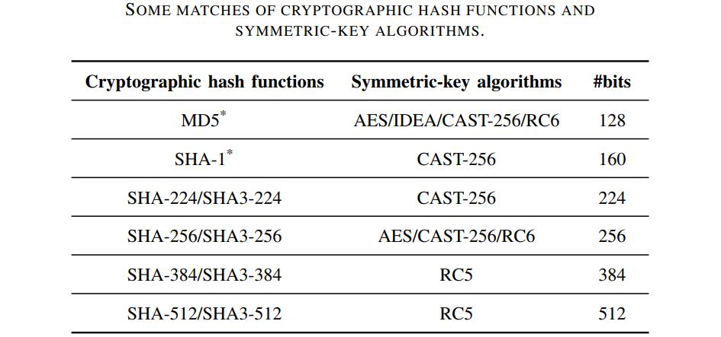
The Cryptographic hash function and the corresponding encryption algorithm must be chosen according to the below table:

Slide 11
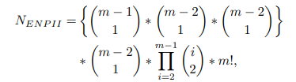
Parameter
1. Hashing Formula: HashedPassword= HashFunction(Password+Salt).
2.Encryption Formula: EncryptedData= EncryptionAlgo(Data, EncryptionKey)
3. Negative Authentication Criteria: Define conditions like FailedAttempts > Threshold or SuspiciousBehaviour == True
4. Monitoring Criteria: Define criteria for triggering alerts, such as Multiple_Failed_Logins or Unsusual_Access_Pattern.
5. Key Management: KeyRotationPeriod= Interval for changing encryption/decryption keys.
6. Number of ENP Generated: The number of ENPs converted from a plain password is calculated by:
7. Performances of ENP : The time complexity of the generation of ENP is O(m2 ), and the time complexity of the verification of ENP is also O(m2 ), where m is the length of the hashed password. Since the length of the hashed passwords in the ENP is smaller, the generation and verification of the ENP are efficient.

Slide 12
Experiment Environment
Hardware Requirements : Intel Core i3 or more,
RAM Capacity : 4GB or more
Frontend framework : Django
Programming language : Python
Database : MySQL
IDE : Visual Studio Code

Slide 13
Project status
S.No | Functionality | Status (Completed /in-progress/Not started)
1. | Literature Survey | Completed
2. | Planning and Design | In Progress
3. | Implementation | Not Started
4. | Closure | Not Started

Slide 14
References
[1] Wenjian Luo, Senior Member, IEEE, Yamin Hu, Hao Jiang, and Junteng Wang, “Authentication by Encrypted Negative Password”, Transactions on Information Forensics and Security, vol. 14, pp. 114-128, 2019
[2]J. Bonneau, C. Herley, P. C. van Oorschot, and F. Stajano, “Passwords and the evolution of imperfect authentication,” Communications of the ACM, vol. 58, no. 7, pp. 78–87, Jun. 2015.
[3] J. Ma, W. Yang, M. Luo, and N. Li, “A study of probabilistic password models,” in Proceedings of 2014 IEEE Symposium on Security and Privacy, May 2014, pp. 689–704.
.

Slide 15
Thank you

Slide 16
Project seminar–I Evaluation
S.No | Rubrics | Marks
1 | Concept Introduction | 4
2 | Literature and Parameter | 5
3 | Problem and Problem Illustration | 8
4 | Proposed Method and Illustration | 8
Total |  | 25

